Slide 1
CSE496 System Estimating Tomato Size on Branches in Greenhouses
CSE 496
First Presentation
Emre YILMAZ
Project Supervisor: Prof. Dr. Yusuf Sinan Akgül
March 2024

Slide 2
Content
Project Scheme and Description
Project Design Plan
Project Requirements
Project Timeline
Success Criterias
References

Slide 3
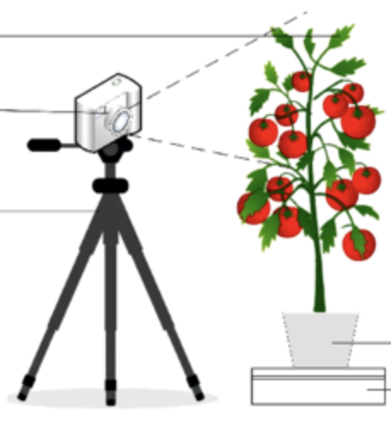
Project Scheme and Description
Monitoring the number of flowers on a plant provides valuable insights into its reproductive health and potential yield
Quantifying tomato yield allows farmers to assess the effectiveness of their cultivation practices and make informed decisions.
Monitoring changes in tomato size provides real-time feedback on plant growth and fruit development dynamics.
Model
*[0]
«3 tomatoes»
«3 flowers»
«12% size increase»

Slide 4
Project Design Plan
Data collection and preprocessing
Collect data using an RGB-D Camera.
Annotate images manually to mark the position and size of tomatoes and flowers
Develop and train AI models for tomato detection and flower counting.
A model calculates the size of the tomato (minor-axis length and major-axis length )
RGBD
Camera
Dataset
Label
Model Train
Model
Train
Tomato
Picture
Output

Slide 5
Project Requirements - 1
Create a dataset of images taken from different angles using an RGB-D camera.
Manually label the position and size of tomatoes and flowers for each image.
Develop a model using deep learning techniques to detect and size tomatoes.
Create a separate model to count the flowers.
Use the trained model to detect tomatoes and flowers.
Calculate the total size of tomatoes in millimeter using the detected tomatoes.
Design a user-friendly interface to understand the results and create appropriate graphs and tables to visualize them.
The developed system accurately calculates the size of tomatoes and counts the number of flowers in the images.

Slide 6
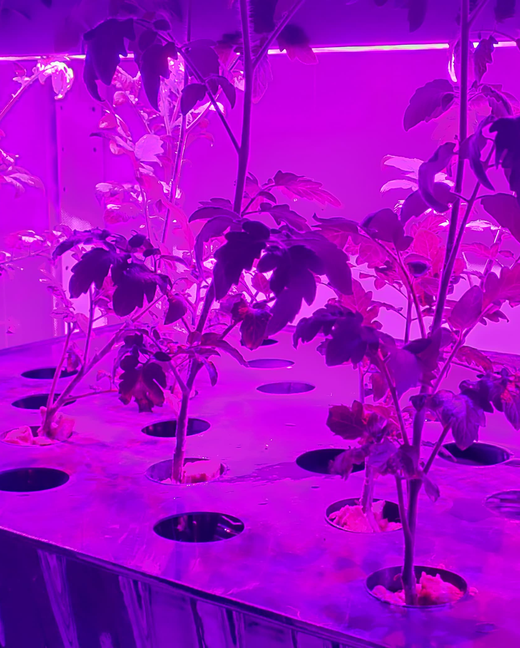
Project Requirements - 2
Hardware
RGB-D Camera ( Intel RealSense )
Software
Data Manipulation: pandas, NumPy
Machine Learning: scikit-learn
Deep Learning: TensorFlow, Keras, PyTorch
Data Visualization: Matplotlib, Seaborn
Other
Flashlight (?)
Dataset, Annotated Data
Training Resource (Google Colab)

Slide 7
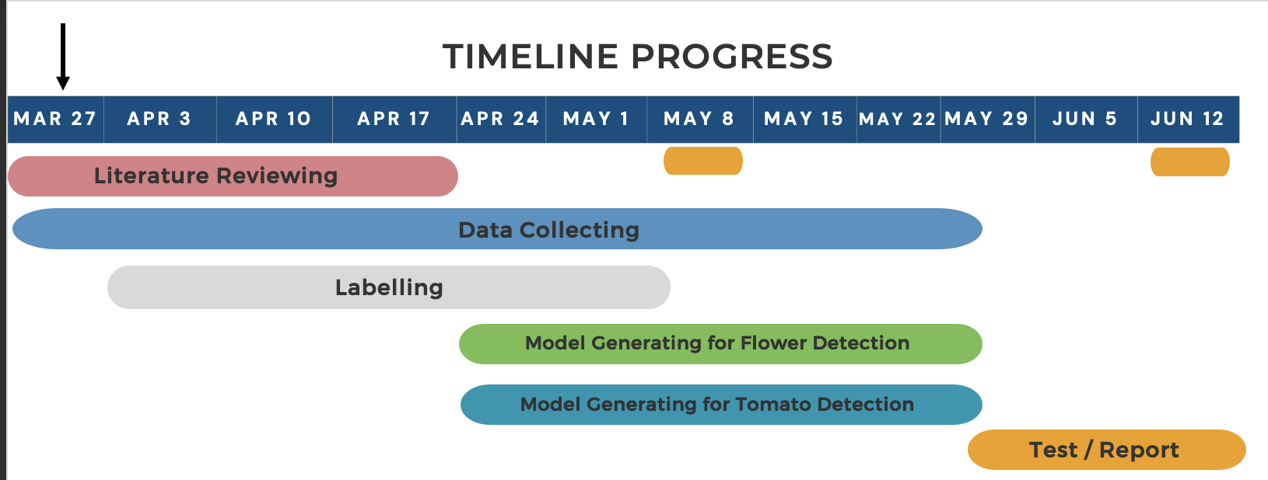
Timeline

Slide 8
Success Criterias
Flower Detection
The system should accurately detect and count the number of flowers in the captured images with a F1 Score of at least 85%.
Tomato Detection
F1 score for tomato detection should exceed 85%
Tomato Size Estimation:
The system should accurately estimate the size of tomatoes in millimeters, with an average error of less than 10% compared to ground truth measurements.

Slide 9
References
[0]: Study on the detection of water status of tomato (Solanum lycopersicum L.) by multimodal deep learning
[1]: Vegetable Size Measurement Based on Stereo Camera and Keypoints Detection
[2]: Tomato volume and mass estimation using computer vision and machine T learning algorithms: Cherry tomato model

